Slide 1
Computational Physics
(Lecture 10)
PHY4061

Slide 2
Monte Carlo Simulations
Statistical mechanics of complex physical systems
  Difficult to solve by analytical approaches
  Numerical simulation: indispensable tool
  MD and MC
One of the major numerical techniques developed in the last century
  for evaluating multidimensional integrals
  solving integral equations

Slide 3
Brief History of MC
The name:
  the resemblance of the technique of playing and recording your results in a real gambling casino
Comte de Buffon’s needle problem.
Curant: random walk and PDE
Fermi in 1930: random sampling to calculate the interaction between neutrons and the concentrated materials, the diffusion and the transport of neutrons.
Newmann, Fermi, Ulam and Metropolis in the 40’s and 50’s
  Rapid progress to solve statistical physics, transport, economical modeling…

Slide 4
Theory and application in statistical physics
Statistical physics:
  System with large degrees of freedom
A typical problem:
  Suppose we know the Hamiltonian, calculate the average macroscopic observables.
Example: Magnetic system:
  Ising model
  Ferromagnetic system
    Anisotropic along different directions.

Slide 5
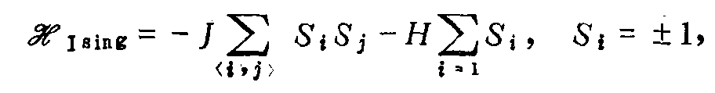

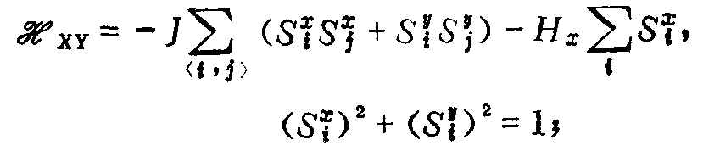
Here, on a lattice point I, the spin is either point up or down.
Exchange energy is only between neighbors.
I is the Zeeman energy
However, If the spin direction is in an x-y plane: (xy model)

Slide 6
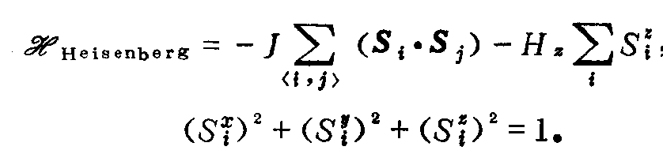
The spin direction isotropic: (Heisenberg Model)
Many more complex models are possible

Slide 7
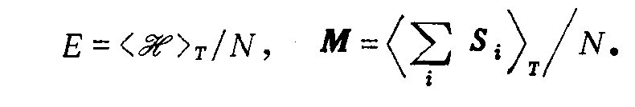

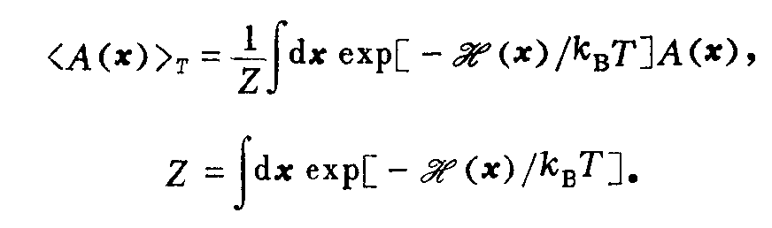
Statistical Average
  Average energy and magnetism for one degree of freedom:
  To any observable A(x),
  x is a vector in the phase space:

Slide 8
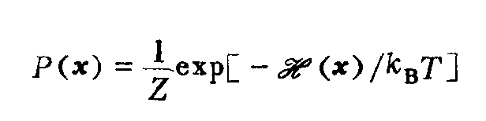
The normalized Boltzmann term:
is the probability density.
What is the unit of probability density?
However, we don’t know how to calculate the integral. (N degrees of freedom)

Slide 9
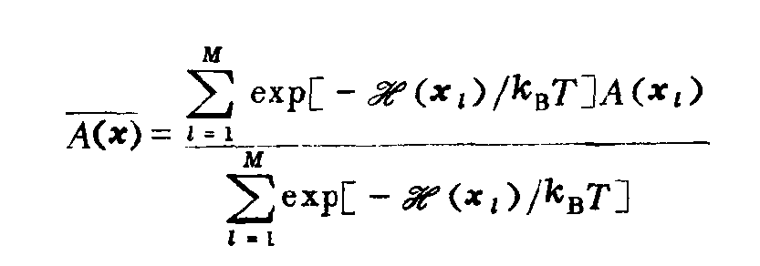
Simple Sampling
Equilibrium statistical mechanism:
  Basic goal:
    Calculate A(x) according to P(x).
  Approximate by using a characteristic subset {x₁, x₂,… x_{N}}
Randomly select the points X from the phase space uniformly (‘simple sampling’)

Slide 10
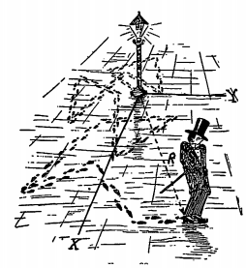
Random Walk
transport processes such as diffusion
  Addition of vectors whose orientation is random
  can be generated both on lattices and in the continuum,
  either choose a uniform step length of the walk,
  or choose the step length from a suitable distribution.
desirable if one wishes to consider
  complicated geometries
  or boundary conditions of the medium where the diffusion takes place

Slide 11
Straightforward to include competing processes
  For example, in a reactor, diffusion of neutrons in the moderator competes with loss of neutrons due to nuclear reactions, radiation going to the outside, etc, or gain of neutrons due to fission events.
This problem of reactor criticality (and related problems for nuclear weapons!) was the starting point for the first largescale applications of Monte Carlo methods by Fermi, von Neumann, Ulam, and their coworkers!

Slide 12
Self-avoiding walks
Widely studied as a simple model for the configurational statistics of polymer chains in good solvents.
Considers a square or simple cubic lattice with coordination
number z.
For a random walk (RW) with N steps
  Z_{RW} = z^{N} configurations
  many of these random walks intersect themselves and thus would not be self-avoiding.
For SAWs,
  only expects of the order of Z_{SAW} configurations,
  Where Z_{SAW} α N^{γ−1}z_{eff} ^{N}, where N -> ∞.
Here γ > 1 is a characteristic exponent (which is believed to be 43/32 in d =2 dimensions (Nienhuis 1984)
while in d =3 dimensions it is only known approximately, 1.16

Slide 13
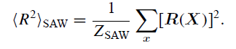
z_{eff} is an ‘effective’ coordination number (also
not known exactly)
Obvious that an exact enumeration of all configurations would be possible for rather small N only
most questions of interest refer to the behavior for large N.
  the use of these methods is fairly limited, and is not discussed here further.
only concerned with Monte Carlo techniques to estimate quantities such as γ or z_{eff} or other quantities of interest
  such as the end-to-end distance of the SAW

Slide 14
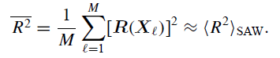
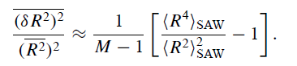
For Monte Carlo simulation:
  Based on a sample of M << Z_{saw}
In the simple sampling generation of SAWs, the M configurations are statistically independent and hence standard error analysis applies.
Relative error:

Slide 15
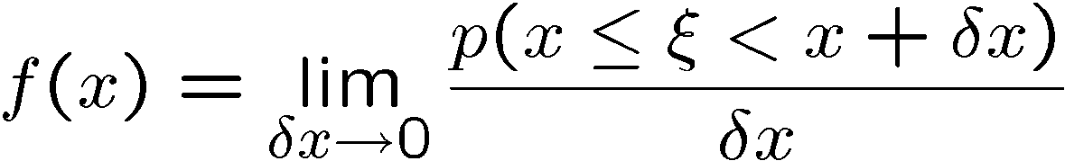
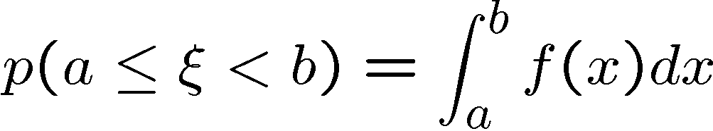
Random variables
Type 1: Discrete randome variables ξ : for each value: x₁, x₂, ☹, x_{n}, ☹ ,
The probability is p₁, p₂, ☹, p_{n}, ☹ .
  P_{i} is the probability distribution of ξ
Another type of random variable: ξ is continuous,
  Suppose the probability of ξ in [x, x+δx] is
p(x <ξ< x+δx),
f(x)is the probability distributional density of ξ, The probability of ξ in [a,b] is given by

Slide 16
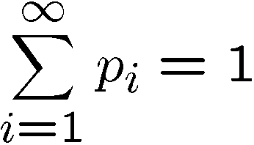
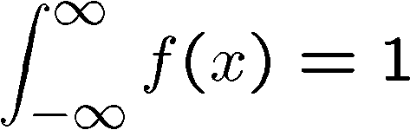
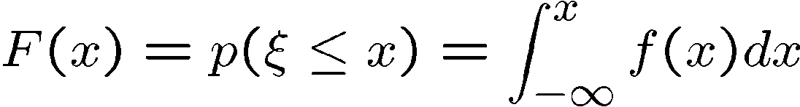
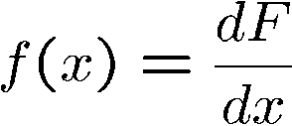
Normalized:
to discrete random variables
to continuous random variables
Distribution function:

Slide 17
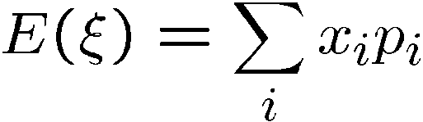
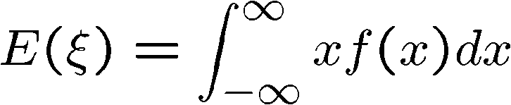
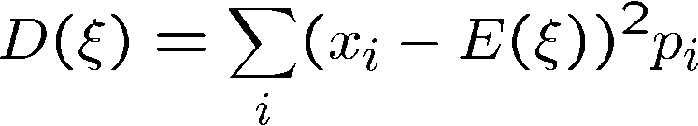
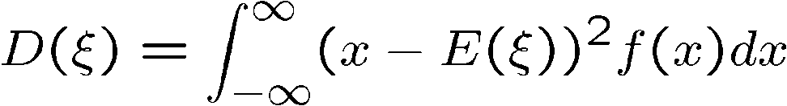
Mathematical expectation value:
or
Square variant:
or

Slide 18
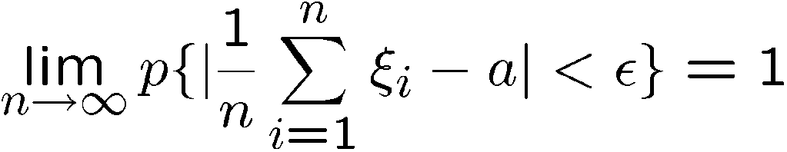
Two Important theorems:
Large number theorem: Suppose ξ₁, ξ₂,☹,ξ_{n},☹ is a sequence of independent
Random variables with the same distribution, and E(ξ_{i})=a, to any ε > 0, we have
This theorem shows that no mater what the random variable distribution is
If n is large enough, the mathematic average converges at the mathematic
expected value.

Slide 19
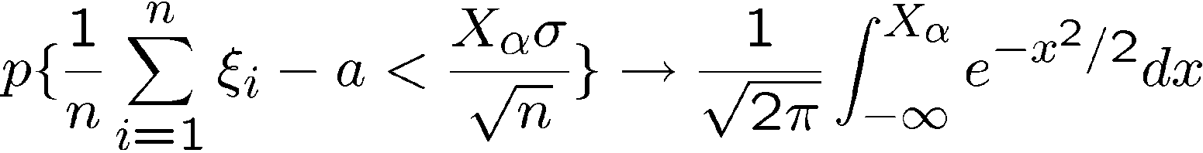
Central limit theorem:
Suppose ξ₁, ξ₂,☹,ξ_{n},☹ are a sequence of independent random variables, with the same distribution, E(ξ_{i})=a, D(ξ_{i})=σ² exist,
The difference of mathematic average and the expected value is normally distributed.

Slide 20
Markov Chain
Construct a process, from any micro state of the system, it migrates to a new state.
We use x_{i} to show the microstate. If we start from x₀, this process will create a sequence of states:
x₁,x₂,☹, x_{i}, ☹ , these state form a chain.
Markov process is a process that each state is only related to the previous state.
From state r to state s, the transfer probability is
w(x_{r}!x_{s}). Markov process creates Markov chain.
  Also called memoryless chain.
To realize normal distribution, we can construct the Markov chain, so that no matter which state we start from, there exists a large number M, after we discard M states, the remainder still satisfies normal distribution.

Slide 21
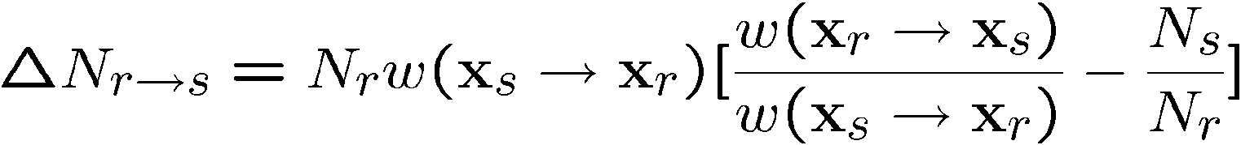
If w(x_{r}!x_{s}) follows the equilibrium condition:
P(x) is the desired distribution. Here it is normal distribution.
To prove it, we consider N parallel Markov chains, for a certain step,
  N_{r} chains are in rth state, N_{s} chains are in s state.
  Therefore, the number of the next state that is from r to s
Is:
  From s to r is:
The number of the net transfer states is:

Slide 22
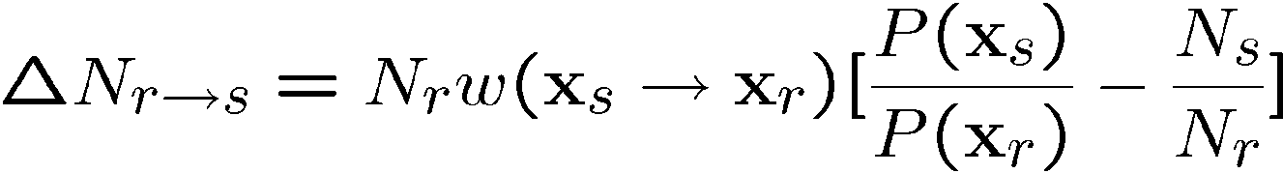
If w( x_{r}! x_{s}) follows the equilibrium condition,
This is a very important result, which indicates that if there are two states that
don’t satisfy normal distribution, the Markov process will tend to help it to satisfy
the normal distribution.

Slide 23
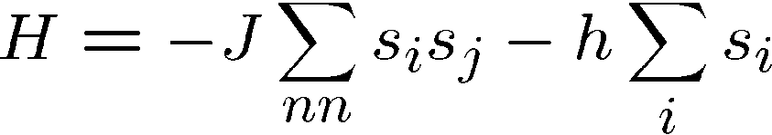
Back to Ising model
Ising model:
Ising is a very simple model proposed by Lenz in 20’s.
Ising gave the solution and proved that no phase change in 1D Ising model.
Onsager found the 2D solution in 1944 and calculated the phase change
temperature.
C. N. Yang solved the 2D Ising model when the h is very small.

Slide 24
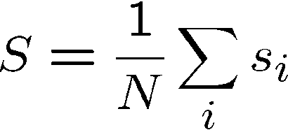
In Ising model, the common interests are energies,
Order parameter,
fluctuation of energies and fluctuation of order parameters.

Slide 25
One algorithm:
♦ Choose a lattice point I, flip the spin.
♦ calculate the energy difference δH.
♦ calculate the transfer probability w.
♦ create uniformly distributed random number ξ [0,1]
♦If ξ<w, flip the spin, Otherwise, no change.
♦Calculate the physical properties.

Slide 26
Discusssion
The choice of lattice point i: could be different.
Two common approaches are: choose the point following the order of lattice index or randomly choose the point.
To randomly choose i, we have to make sure that each lattice point is visited for the same number of times.
Each Monte Carlo Step (MCS) is that we visit each point once.
Thousands or millions of steps will be performed in this calculation.
Since there exists only one spin flip between the current state and the previous state, the physical properties are highly correlated. Therefore, we don’t have to calculate the physical quantities for each step.
Energy difference calculation is time consuming. To Ising model, the energy difference can be only a few values. We can calculate them before the simulation and store them. This is a typical strategy for many MC calculations.

Slide 27
Homework 2 (Due in three weeks after this lecture)
Rewrite the F-L program (which is in java) in the lecture notes (also text book) in C or Fortran and use the revised program to calculate the inversion of a 5x5 matrix (you can just create the 5x5 matrix by yourself).

